Slide 1
Maze Solving Using a Robot
Under the esteemed guidance of
Mrs. K Neeraja
Assistant Professor
B. Rahul Raju (10011P0502)
P. Phaneendra (10011P0514)
Raghav Mishra (10011P0517)
T. Siddartha Reddy (10011P0518)

Slide 2
Presentation Overview
Introduction
Pololu’s 3pi Robot
Maze Solving Robot
Implementations
Experimental Results
Conclusion and Future Work

Slide 3
Introduction

Slide 4
Introduction
Robotics : Robotics is the branch of technology that deals with the design, construction, operation, and application of robots, as well as computer systems for their control, sensory feedback, and information processing.
A robot is a mechanical or virtual artificial agent, usually an electro-mechanical machine that is guided by a computer program or electronic circuitry.
Research in robotic maze solving problems has been highly active for the past few decades in both robotics and artiﬁcial intelligence.

Slide 5
Problem Definition:
In this project the problem of solving a maze is addressed using a robot. The maze has a source or a starting point with several routes branching out from it.
There is a destination or ending point which is connected through several routes and not all the routes from the source connect to the destination point.
There maybe several dead-ends in the maze and also many unfeasible paths from the source to the destination.
The Maze is solved by a robot in its first run where it learns the maze structure and finds the path to be taken to reach the destination.
Thus , the robot in its subsequent runs, can run through the maze in a definite path to reach the destination.

Slide 6
Pololu’s 3pi Robot

Slide 7
Pololu’s 3pi Robot
The Pololu 3pi robot is a small, high-performance, autonomous robot designed to excel in line-following and line maze - solving competitions.
Powered by four AAA batteries and a unique power system that runs the motors at a regulated 9.25V, 3pi is capable of speeds up to 100 cm/second while making precise turns and spins that don’t vary with the battery voltage.

Slide 8
Pololu’s 3pi Robot
The 3pi is based on an Atmel ATmega168 or ATmega328 microcontroller, henceforth referred to as the “ATmegaxx8”, running at 20 MHz.
ATmega168-based 3pi robots feature 16 KB of flash program memory and 1 KB RAM, and 512 bytes of persistent EEPROM memory.
ATmega328-based 3pi robots feature 32 KB of flash program memory, 2 KB RAM, and 1 KB of persistent EEPROM memory.

Slide 9
Pololu’s 3pi Robot
3pi Robot simplified schematic diagram:

Slide 10
Pololu’s 3pi Robot
1. Battery: This demo displays the battery voltage in millivolts, which should be above 5000 (5.0 Volts) for a fully-charged set of batteries. Removing the jumper marked ADC6 will separate the battery voltage measurement circuit from the analog input, causing the number displayed to drop to some low value.
2. LEDs: Blinks the red and green user LEDs on the underside of the board. If you have soldered in the optional user LEDs, they will also blink.
3. Trimpot: Displays the position of the user trimmer potentiometer, which is located on the underside of the board, as a number between 0 and 1023. While displaying the value, this demo also blinks the LEDs and plays a note whose frequency is a function of the current reading. It is easiest to turn the trimpot using a 2mm flat-head screwdriver.

Slide 11
Pololu’s 3pi Robot
4. Sensors: Show the current readings of the IR sensors using a bar graph. Bigger bars mean lower reflectance. Placing a reflective object such as your finger under one of the sensors will cause the corresponding reading to drop visibly on the graph. This demo also displays “C” to indicate that button C has an effect—press C and the IR emitters will be turned off. In indoor lighting conditions away from bright incandescent or halogen lights, all of the sensors should return entirely black readings with IR off. Removing the jumper marked PC5 disables control of the emitters, causing them to always be on.
5. Music: Plays an adaptation of J. S. Bach’s Fugue in D Minor for microcontroller and piezo, while scrolling a text display. This demonstrates the ability of the 3pi to play music in the background.

Slide 12
Pololu’s 3pi Robot
6. Motors: Hold down A or C to run the motor on the corresponding side, or hold down both buttons to run both motors simultaneously. The motors will gradually ramp up to speed; in your own programs, you can switch them on much more suddenly. Tap A or C to switch the corresponding motor to reverse (the button letter becomes lowercase if pressing it will drive the corresponding motor in reverse).
7. Timer: A simple stopwatch. Press C to start or stop the stopwatch and A to reset. The stopwatch continues to count while you are exploring the other demos.

Slide 13
Pololu’s 3pi Robot

Slide 14
Pololu’s 3pi Robot

Slide 15
Maze Solving Robot

Slide 16
Maze Solving Robot
A Maze solving robot is a robot that is used to solve the given maze in an environment. The robot starts at any point on the maze and traverses through the track to reach the specific destination.
The robot in its first run , travels throughout the maze and learns the maze. It records the dead ends as unreachable paths and remembers the turns it has taken at the intersections.
The robot using its five reflectance sensors senses the track a black colored line and follows it until a dead end is encountered and notes it an unreachable path.

Slide 17
Maze Solving Robot
The intersections are also recorded and the turns taken are remembered. Finally, first run is completed when the robot reaches the destination successfully
The path stored remembered is simplified for avoiding unnecessary turns. In its second run , the robot travels through the track in the simplified path. The robot thus reaches the destination.
The Maze Solving problem is solved using an algorithm “Left Hand On The Wall”.

Slide 18
Left Hand On The Wall Algorithm
The basic strategy for solving a non-looped maze is called “left hand on the wall”.
Imagine walking through a real labyrinth – a human-sized maze built with stone walls – while keeping your left hand on the wall at all times.
You’ll turn left whenever possible and only turn right at an intersection if there is no other exit.
Sometimes, when you reach a dead end, you’ll turn 180 degrees to the right and start walking back the way you came.

Slide 19
Left Hand On The Wall Algorithm
Eventually, as long as there are no loops, your hand will travel along each length of wall in the entire labyrinth exactly once, and you’ll find your way back to the entrance.
If there is a room somewhere in the labyrinth with a monster or some treasure, you’ll find that on the way, since you’ll travel down every hallway exactly twice.

Slide 20
Implementation
Simplifying the Solution:

Slide 21
Implementation:
The heart of the maze solving program is maze_solve() function.
void maze_solve();
It consists of an array path[path_length] to store the path i.e the directions taken at various intersections.
The desired direction is taken based on the readings of the five sensors. The turnings are taken using the turn(dir) function.
void turn(char dir);
The path array is now passed to simplify_path() to clean up the turns leading to dead ends and unwanted ends.

Slide 22
Simplifying the Solution
Consider the sequence ‘LBL’, where ‘B’ stands for “back” and is the action taken when a dead end is encountered.
The path can be simplified to a single ‘S’. The following diagram depicts this scenario, showing the two functionally equivalent paths from start to end:

Slide 23
Simplifying the Solution

Slide 24
Simplifying the Solution

Slide 25
Experimental Results

Slide 26
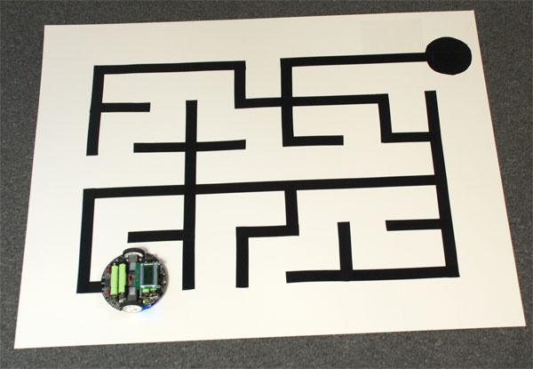
Experimental Results
The Maze which is required to be solved

Slide 27
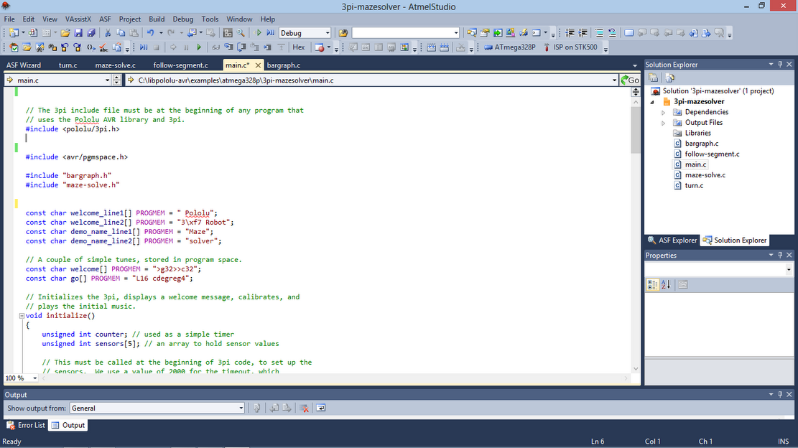
Experimental Results
The Atmel Studio Showing the project solution with different C files

Slide 28
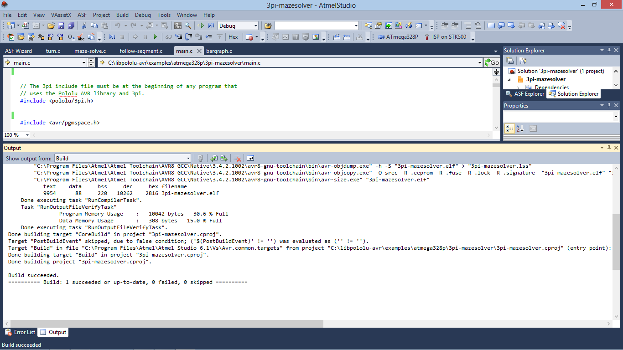
Experimental Results
The Atmel Studio showing the successful build of the program

Slide 29
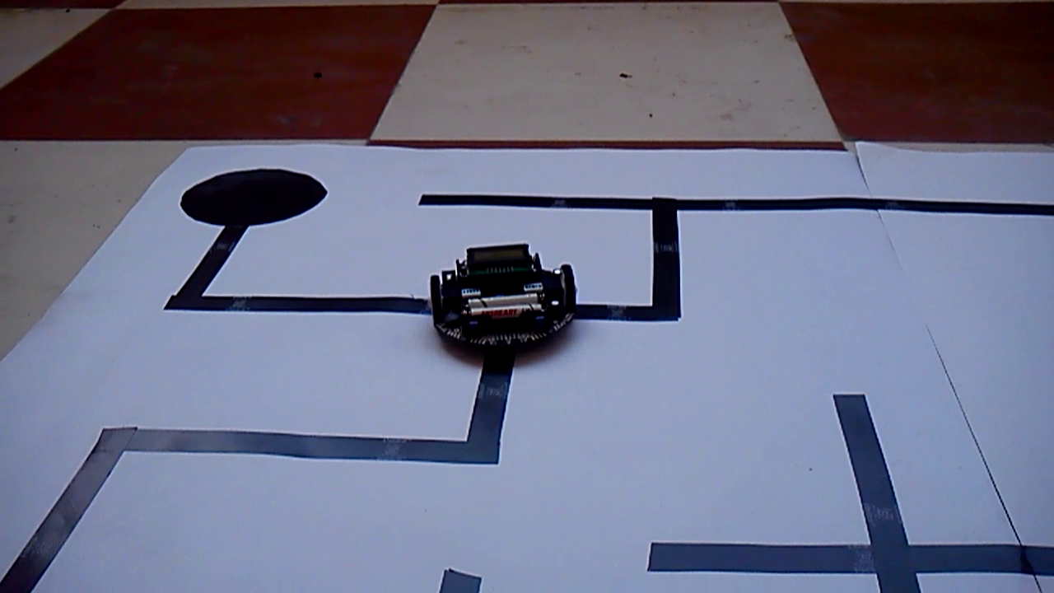
Experimental Results
The Robot taking a left at an intersection in its first run to solve the maze

Slide 30
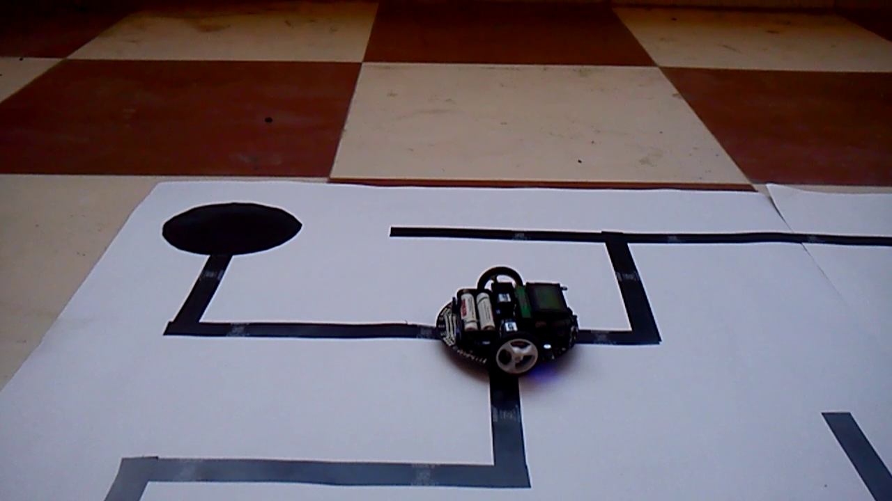
Experimental Results
The robot going straight through the intersection after solving the Maze.

Slide 31
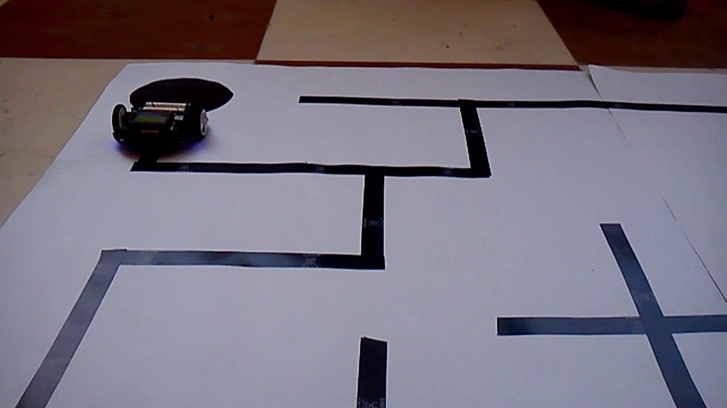
Experimental Results
The robot after reaching the destination.

Slide 32
Conclusion and Future Work

Slide 33
Conclusion
This project deals with the successful maze solving using a 3pi robot. The robot uses the left hand on the wall algorithm to solve the maze and uses the sensors to identify the path.
The threshold values of the sensors are taken differently at different instances of the maze solving phase of the robot.
These different threshold values are used for certain implications.
This maze solving robot can be used in situations where the identification of the feasible path from the source to the destination is difficult by general perception.
The Maze is solved in the first run and the robot traverses the maze in a definite and optimal path in its subsequent runs.

Slide 34
Future Work
In this project, we address the problem of solving a maze using the left hand on the wall algorithm .
The functionality of the robot can be further increased by implementing much better and advanced algorithms.
In this system the robot uses sensors in order to identify the path and the destination points, other functionalities such as video cameras can also be installed in order to identify the path by visual perception.
The robot with the help of sensors could identify the end points in the path, but with some modifications in the code it can be also made to identify obstacles in its path along with the end points.

Slide 35
Future Work
Thus it can be made to work in a dynamic environment with obstacles. The scope of the dynamic environment is large depending on the nature of the obstacles, i.e static or dynamic in nature.
Thus the maze solving robot can be used to solve the maze in much more complex and dynamic situations in a more intelligent manner.
These robots with obstacle detection using Distance Measuring Sensors can be used for developing equipment that can be used by blind people .
With some sophisticated algorithms and more advanced sensors , the robot can be used in path detection and following in Real World where they can be used to supply ammo in military bases or to mine the coal in Coal Mines.

Slide 36
Thank You

